Slide 1
Chapter 4.1: File System
What is a file system
Objectives and user requirements
Characteristics of files and directories
File system implementation
Directory implementation
Free block management
File system reliability
Increasing file system performance

Slide 2
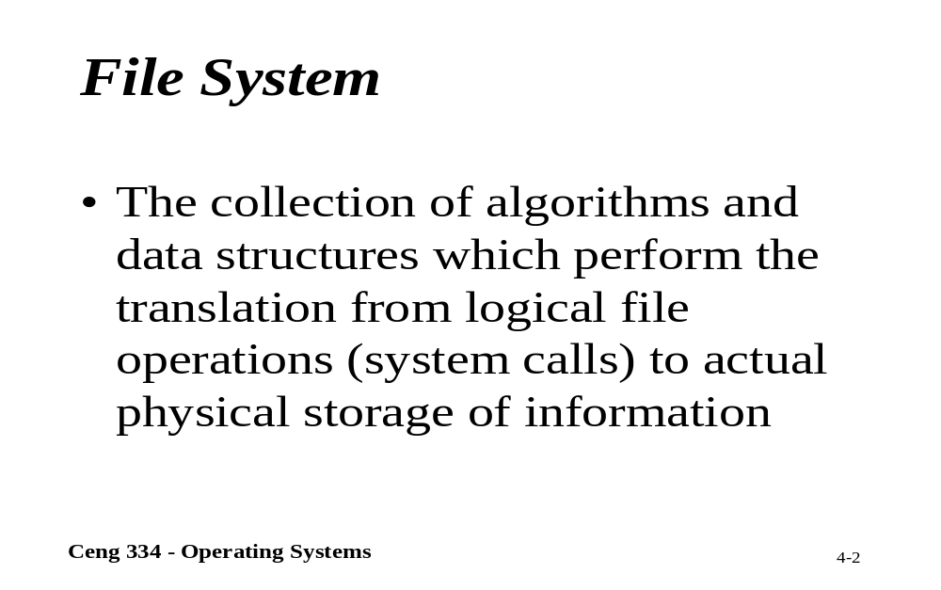
File System

Slide 3
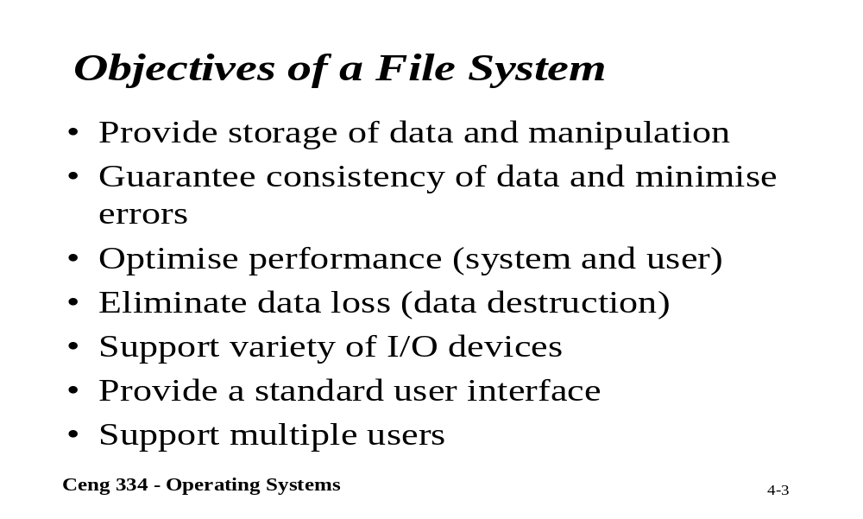
Objectives of a File System

Slide 4
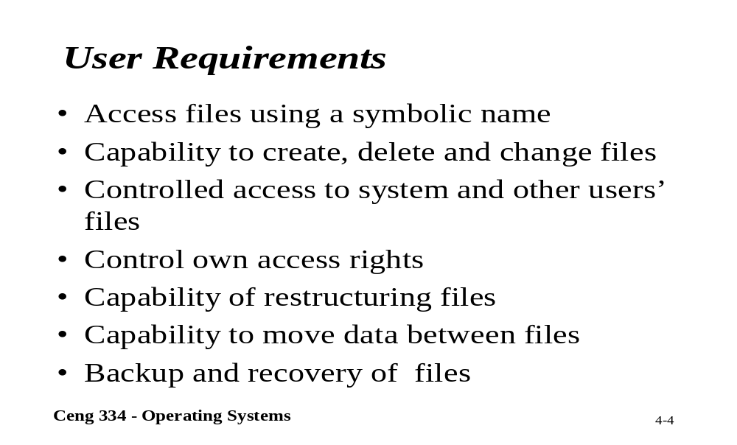
User Requirements

Slide 5
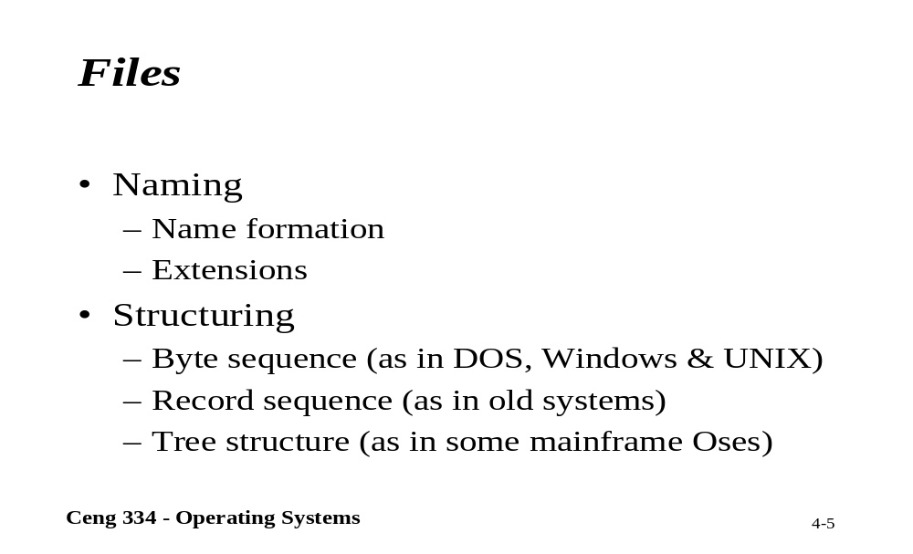
Files

Slide 6
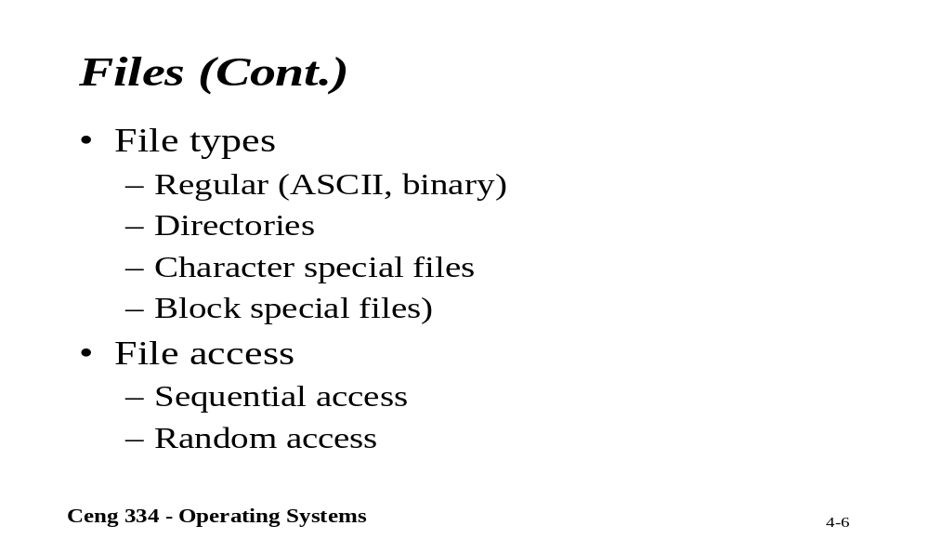
Files

Slide 7
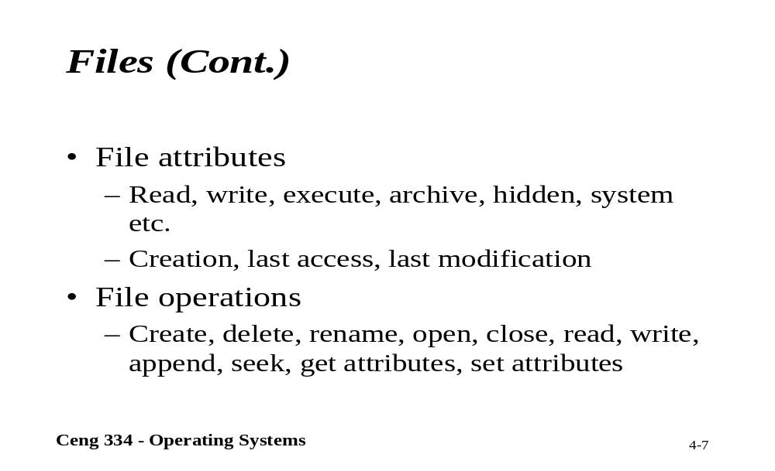
Files

Slide 8
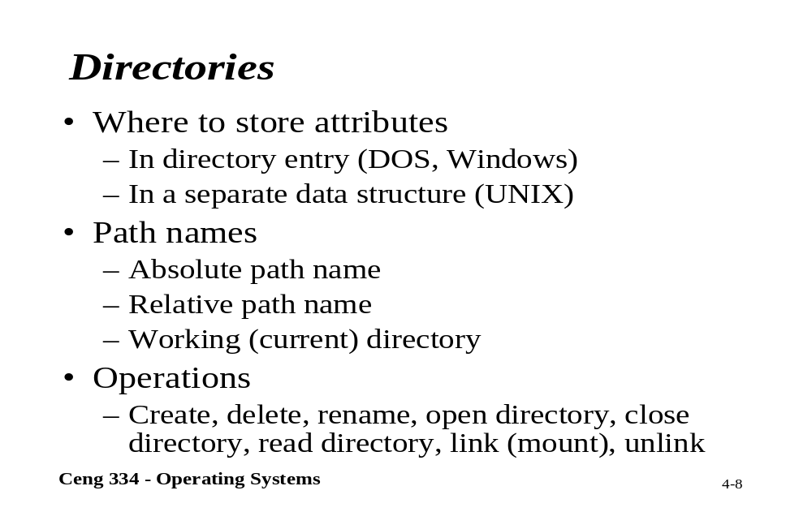
Directories

Slide 9
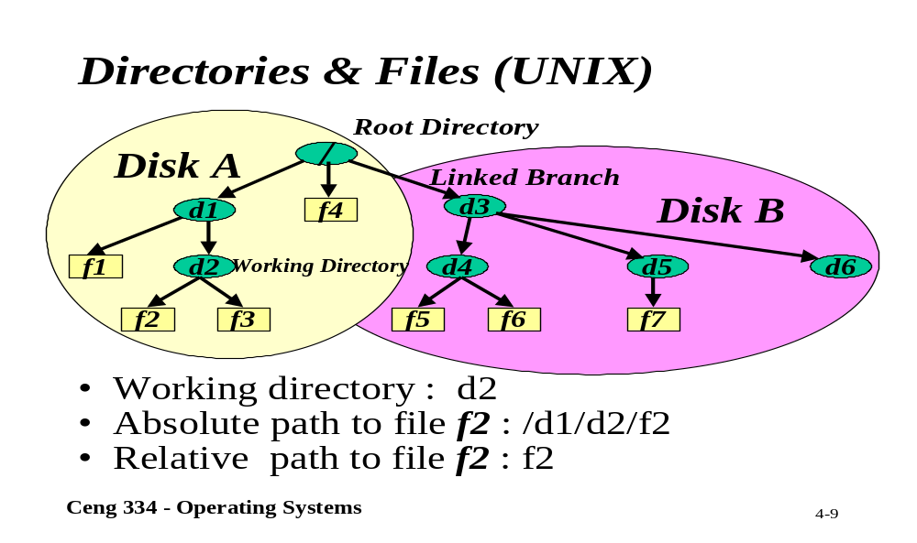
Unix; Directory and Files

Slide 10
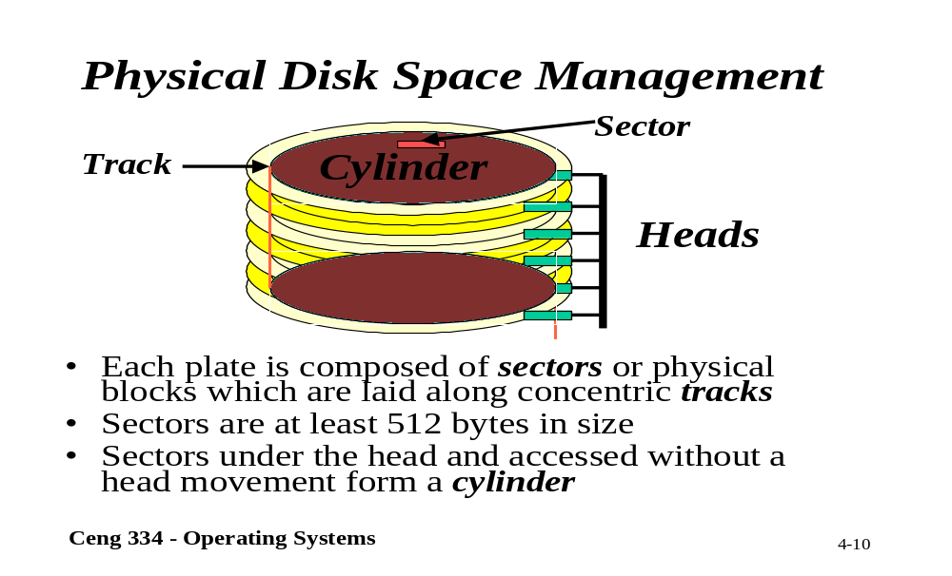
Physical Disk Space Management

Slide 11
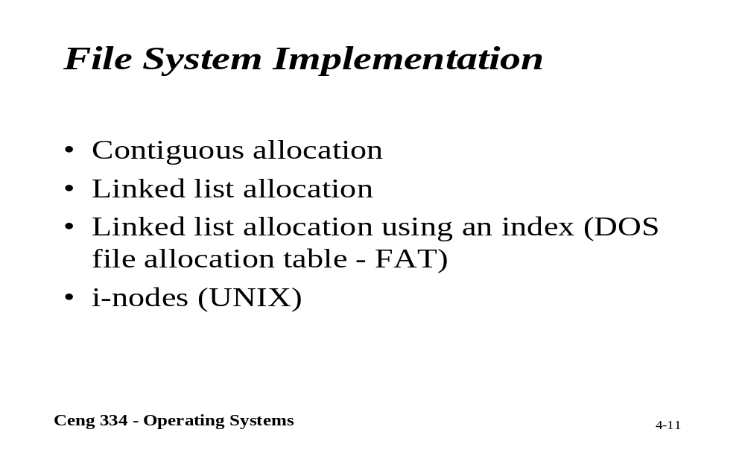
File System Implementation

Slide 12
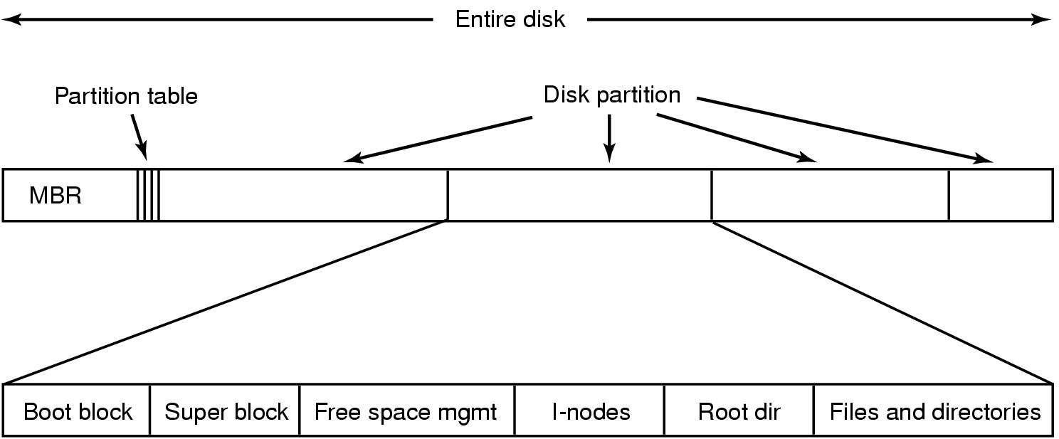
File System Implementation
A possible file system layout
MBR: Master Boot Records is used to boot computer. The end of the MBR contains the partition table. (read boot block and execute)

Slide 13
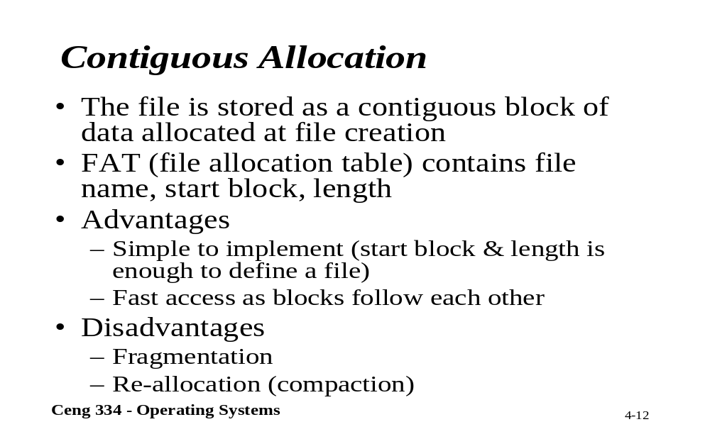
Contiguous Allocation

Slide 14
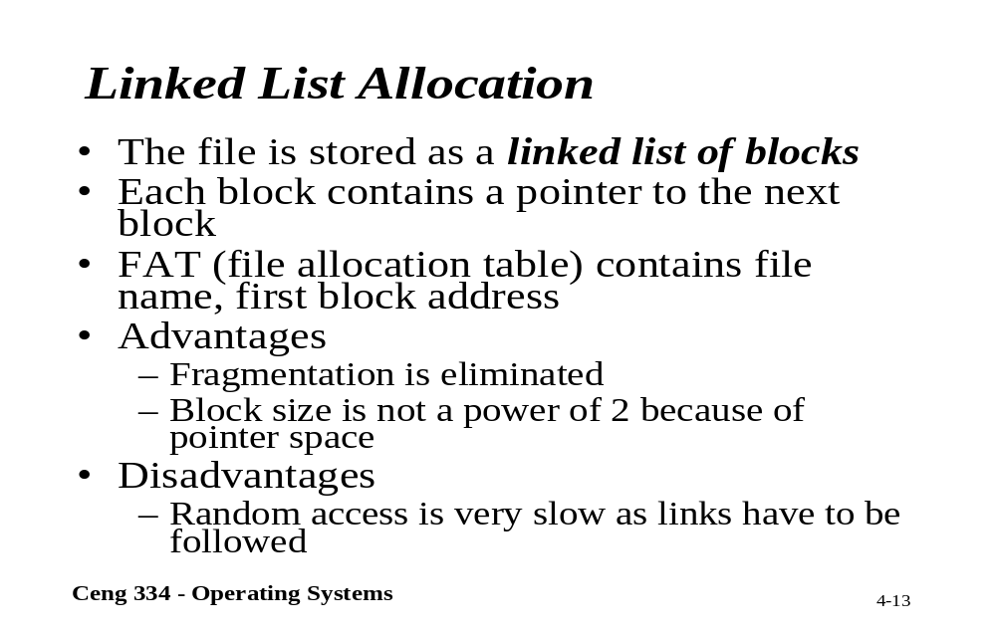
Linked List Allocation

Slide 15
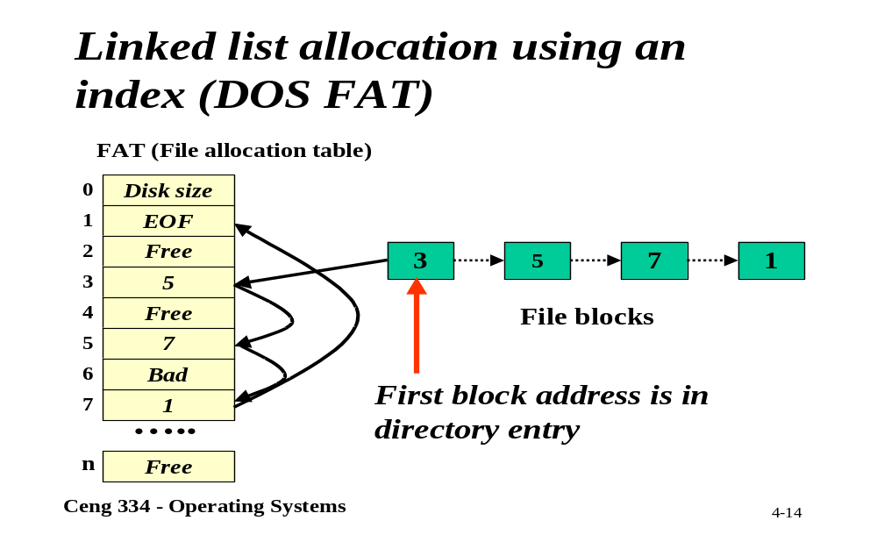
Linked List (DOS FAT)

Slide 16
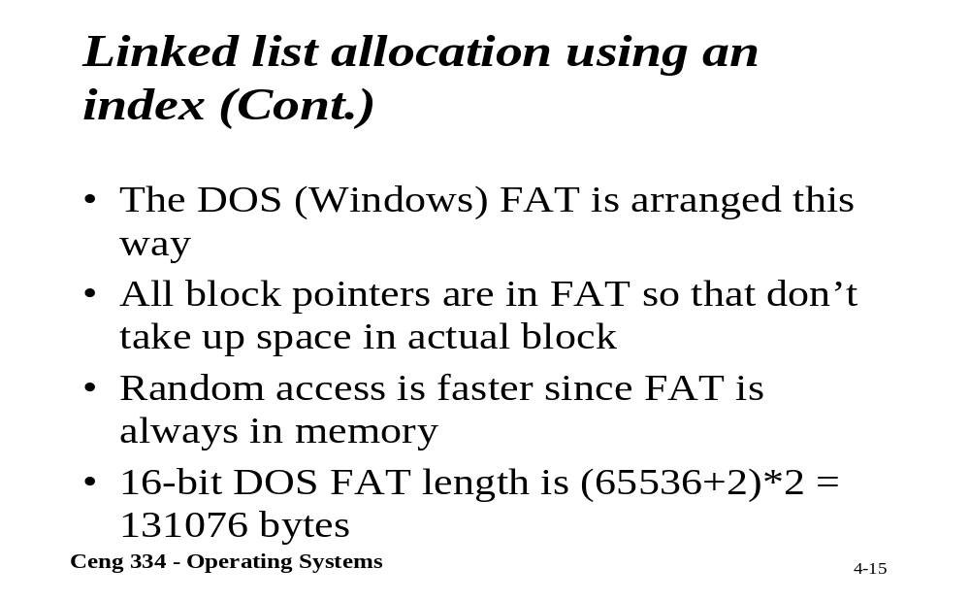
Linked List Using an Index

Slide 17
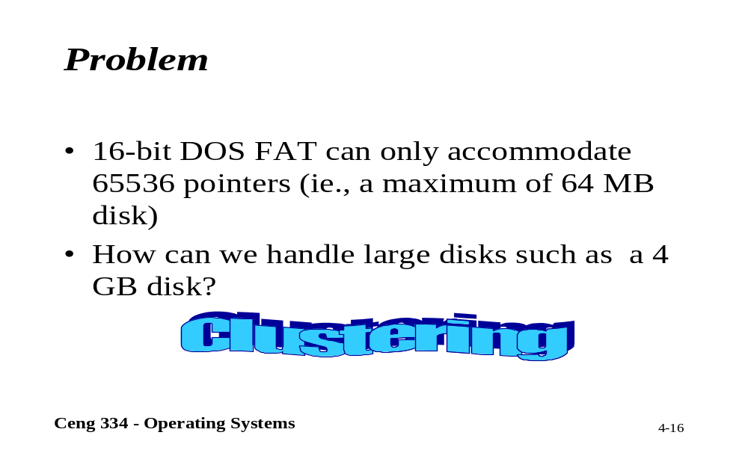
Problems

Slide 18
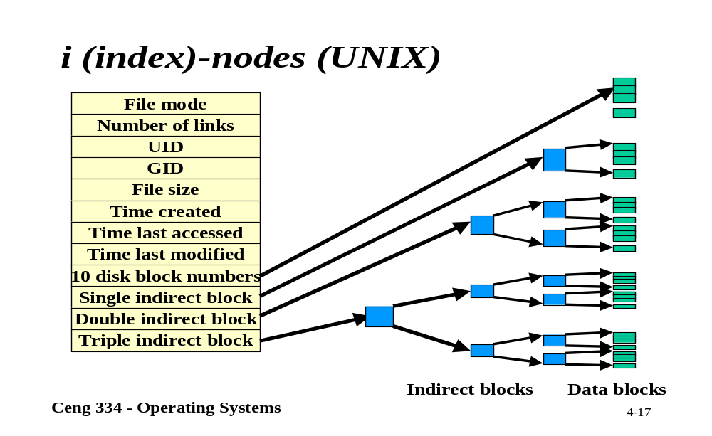
Unix; i-nodes

Slide 19
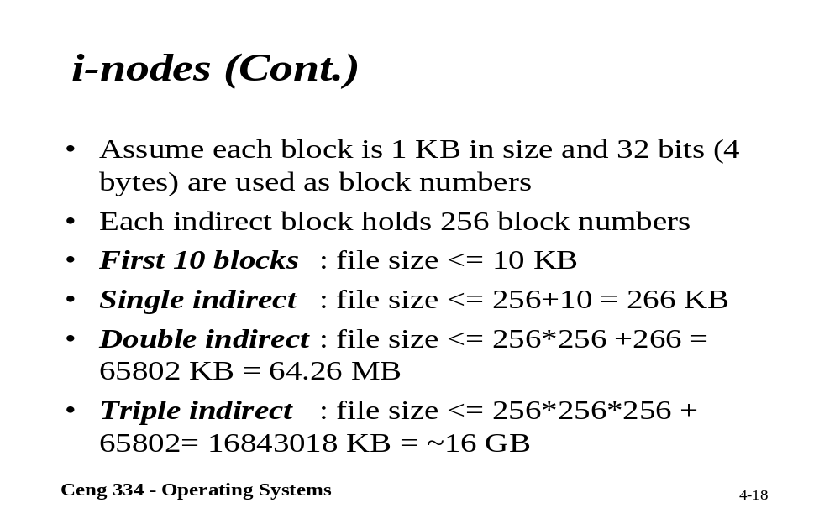
i-nodes

Slide 20
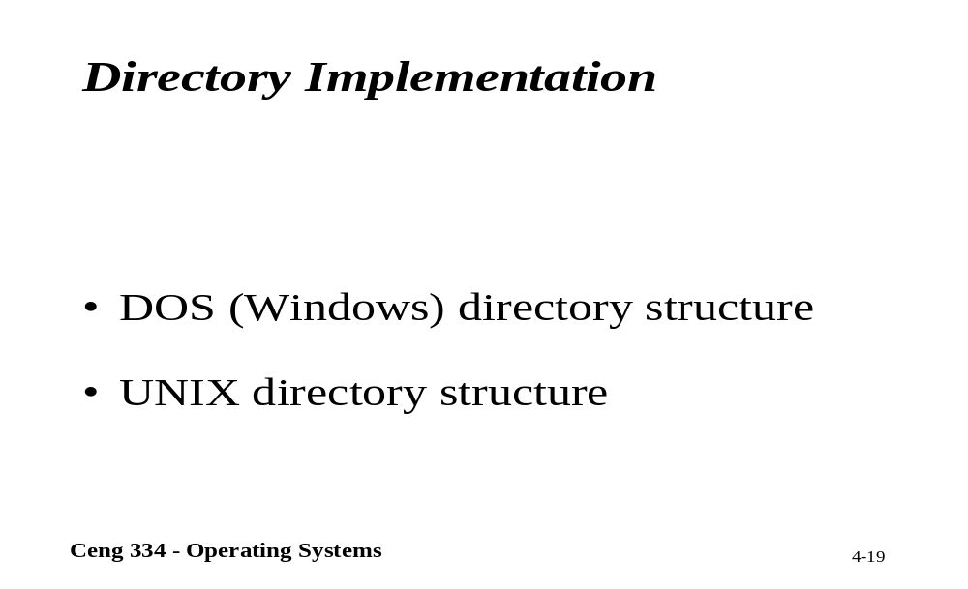
Directory Implementation

Slide 21
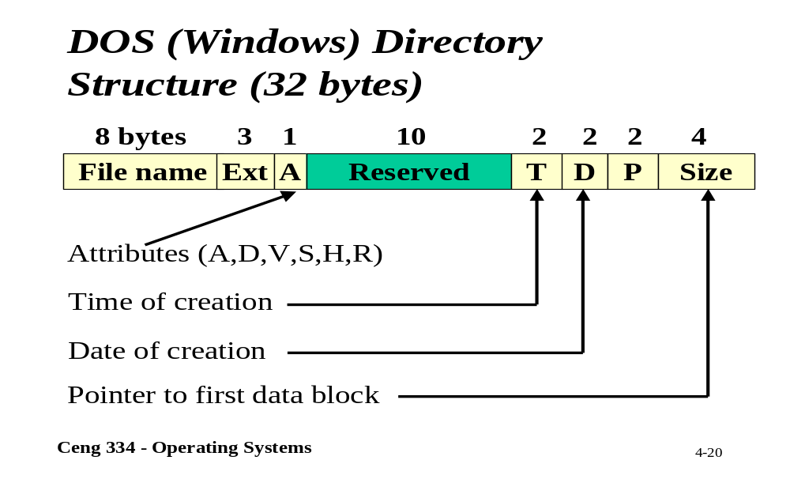
DOS; Directory Structure

Slide 22
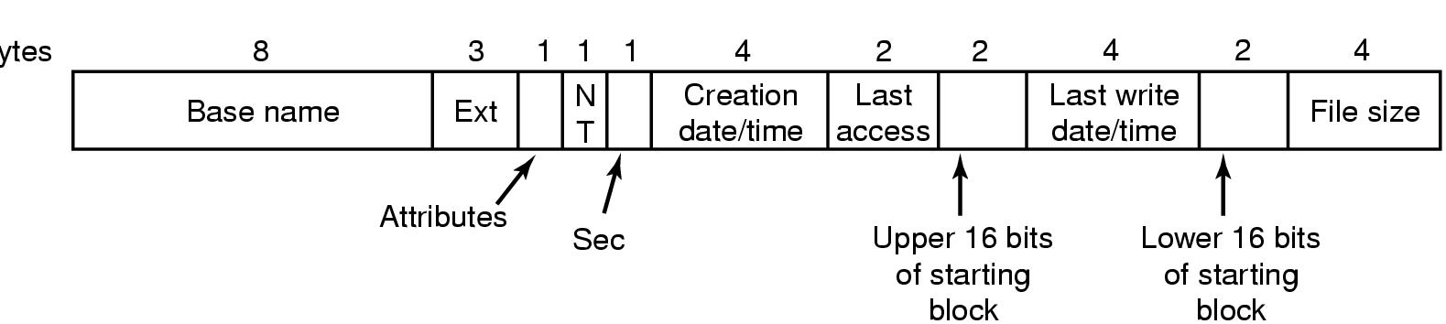
Windows 98: Directory Structure N.
DOS directory entry used in Windows 98

Slide 23
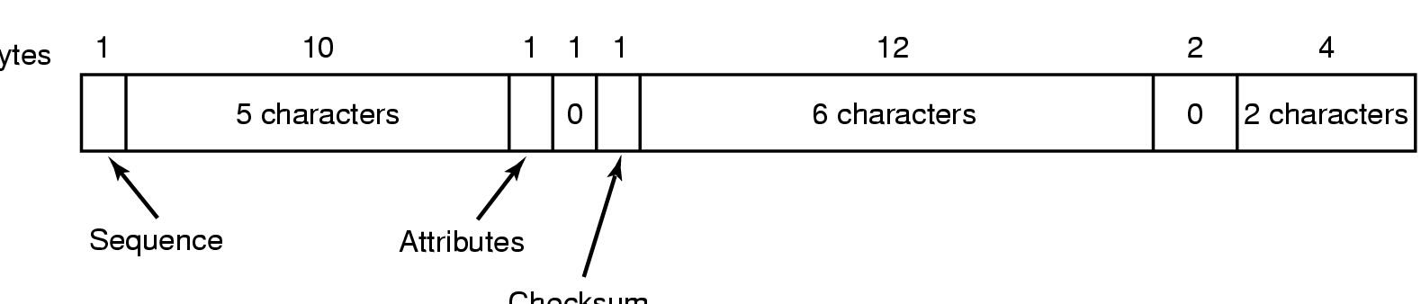
Windows 98: Directory Structure Ext.
An entry for (part of) a long file name in Windows 98.
If attribute is 0x0F, the MS-DOS ignores the entry as invalid.

Slide 24
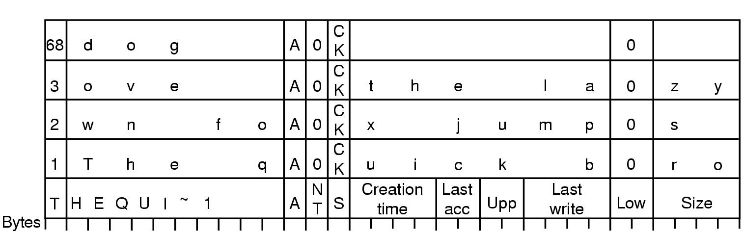
An example of how a long name is stored in Windows 98
6 bit are used for the sequence number and 63013 819 character (long file name are possible).
Because of historic reasons this limited to 260 characters. (last sequence number 68 = 64 + 4 seq. of previous row)
The quick brown fox jumps over the lazy dog.

Slide 25
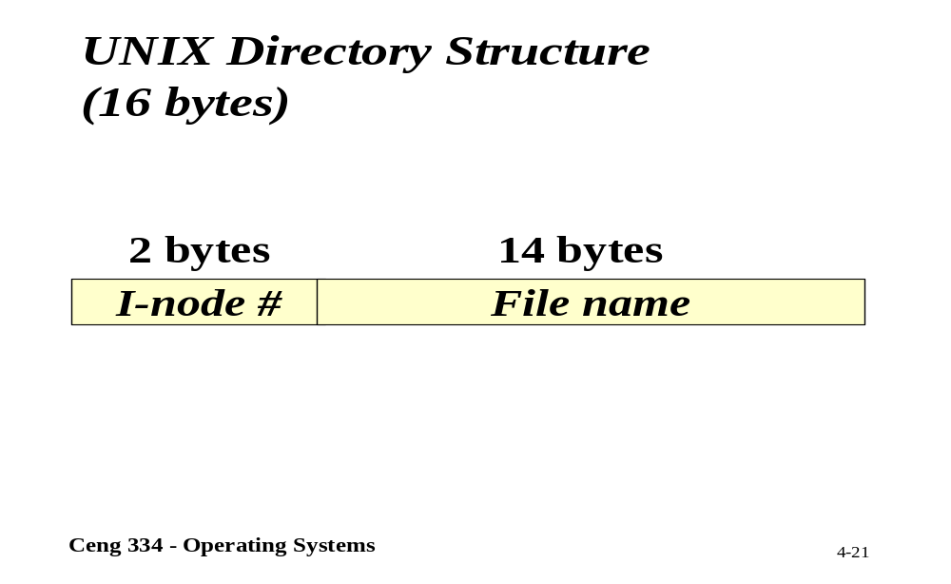
Unix; Directory Structure

Slide 26
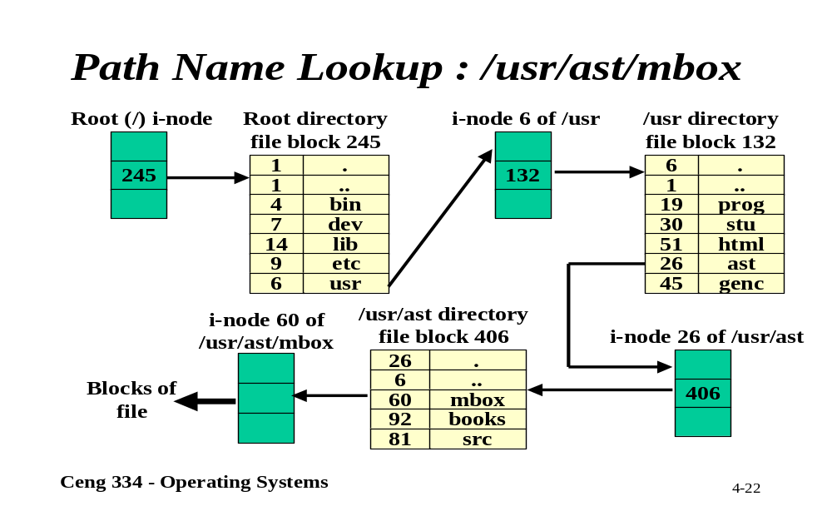
Path Name Lookup

Slide 27
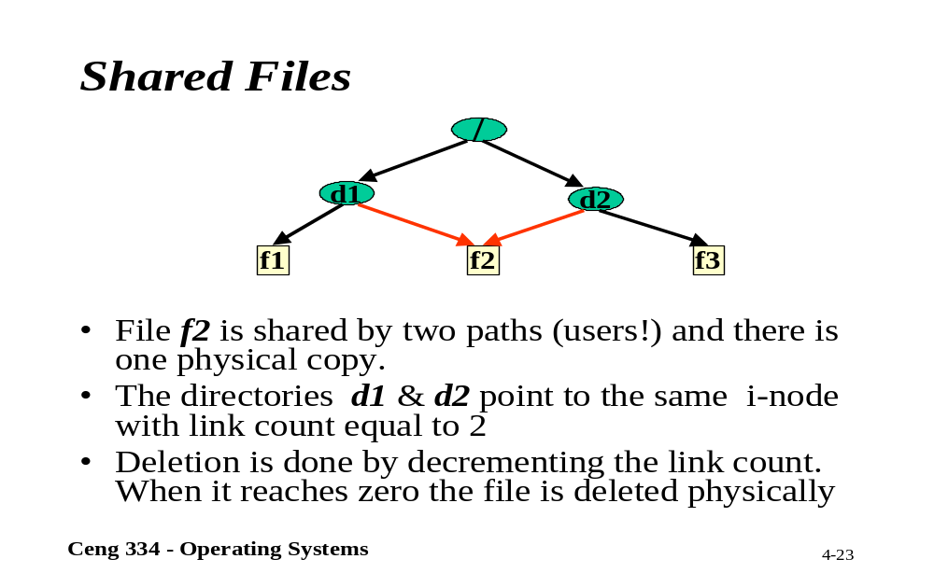
Shared Files

Slide 28
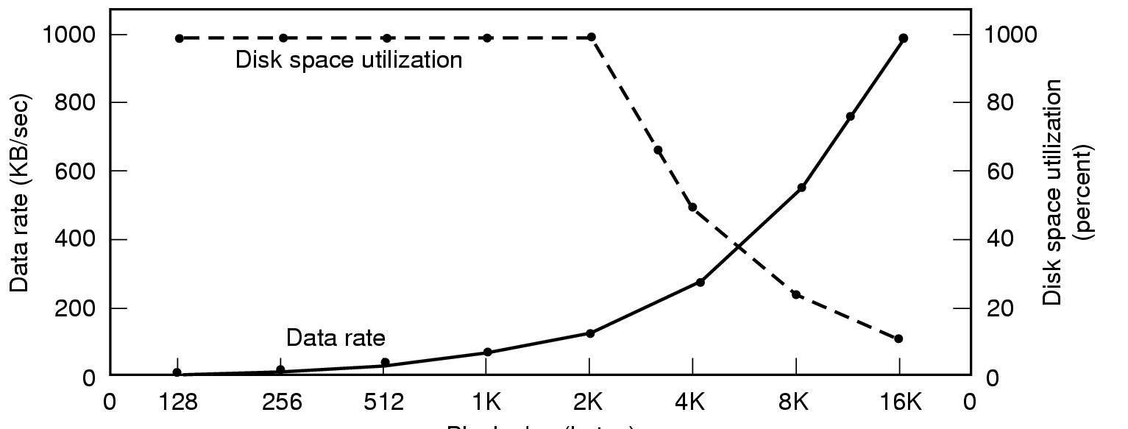
Disk Space Management
Dark line (left hand scale) gives data rate of a disk
Dotted line (right hand scale) gives disk space efficiency
All files 2KB

Slide 29
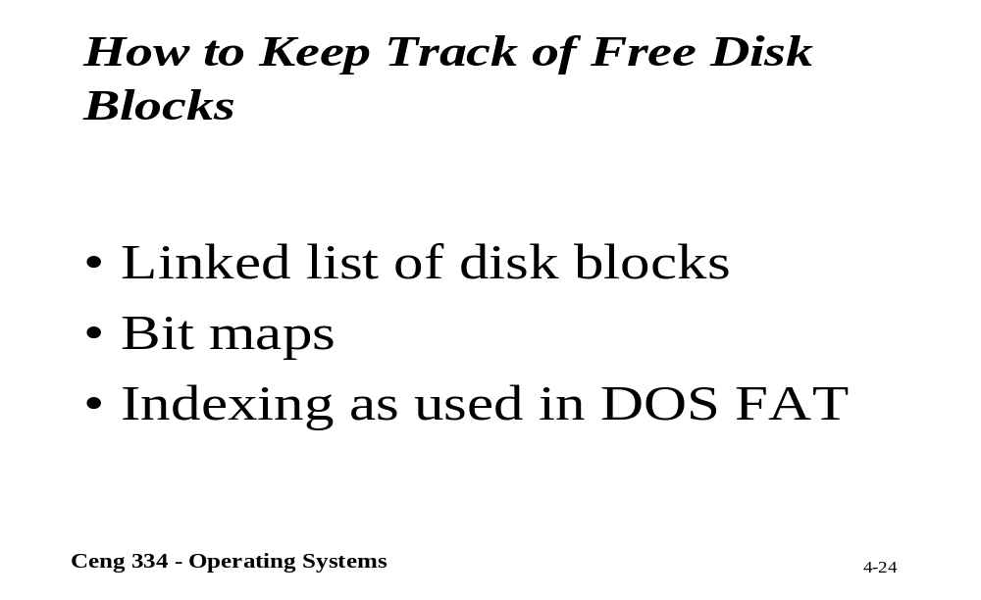
Keeping Track of Disk Blocks

Slide 30
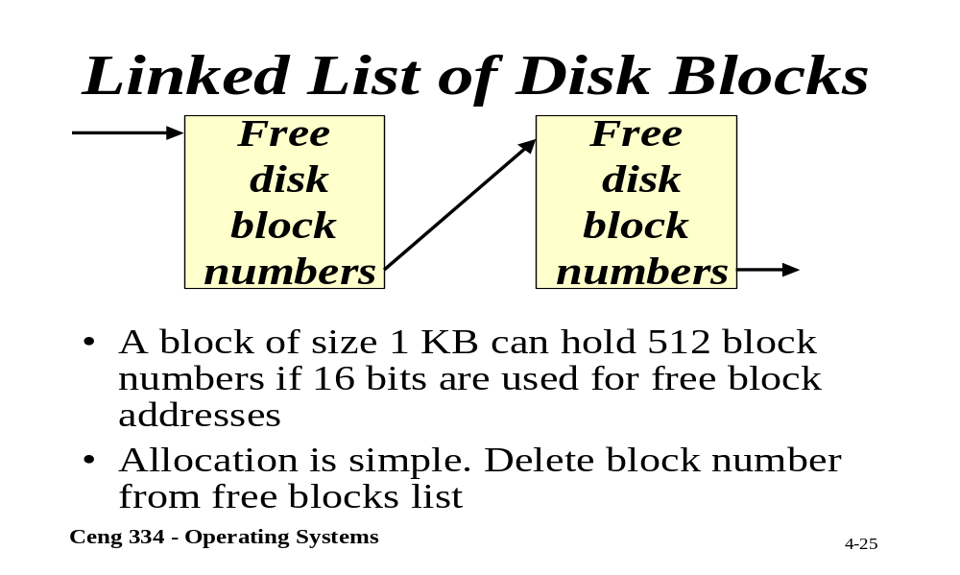
Linked List of Disk Blocks

Slide 31
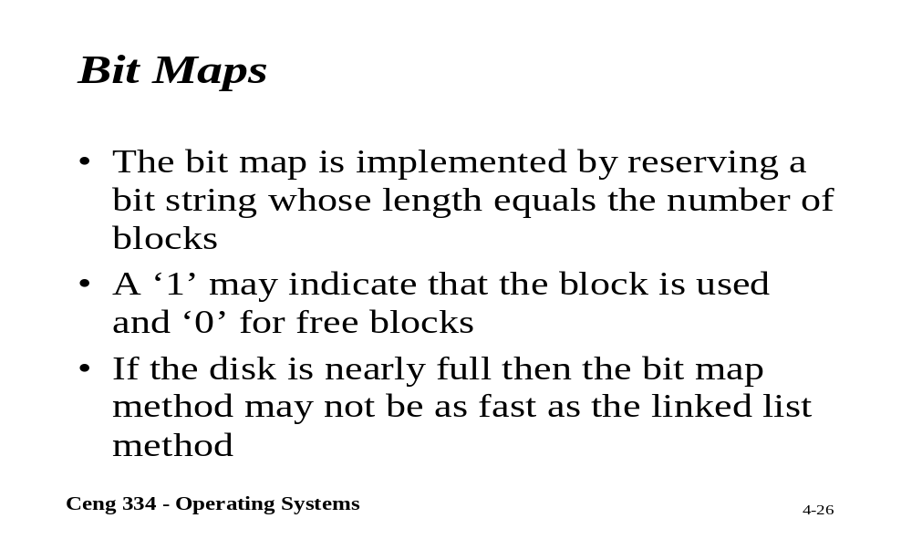
Bit Maps

Slide 32
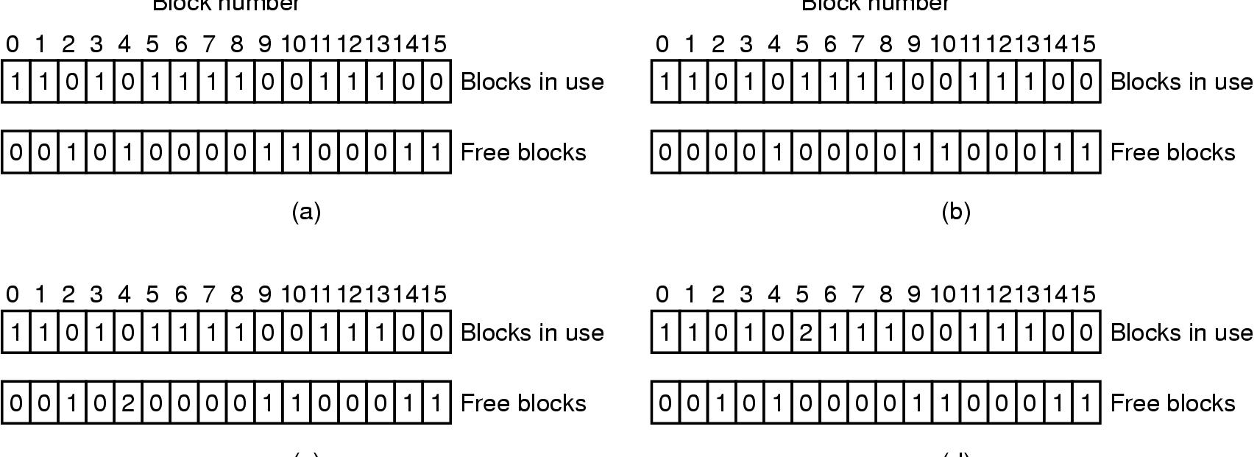
File System Reliability
File system states
  (a) consistent
  (b) missing block
  (c) duplicate block in free list
  (d) duplicate data block

Slide 33
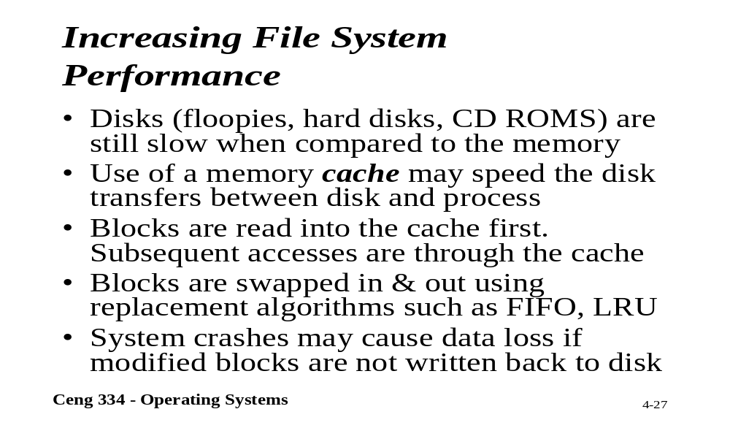
File System Performance

Slide 34
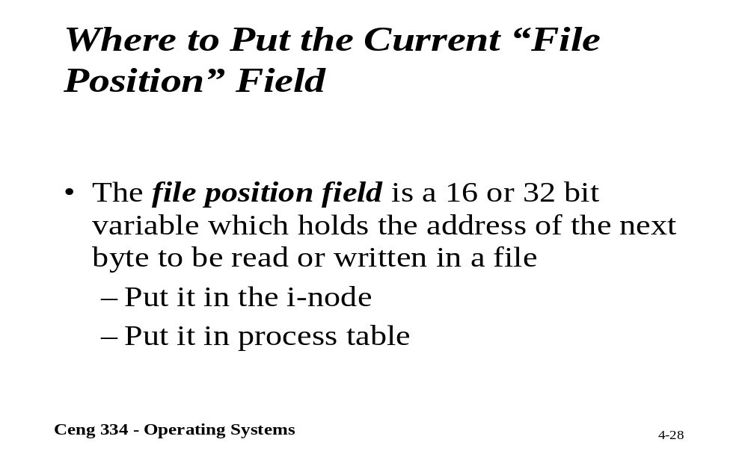
File Position

Slide 35
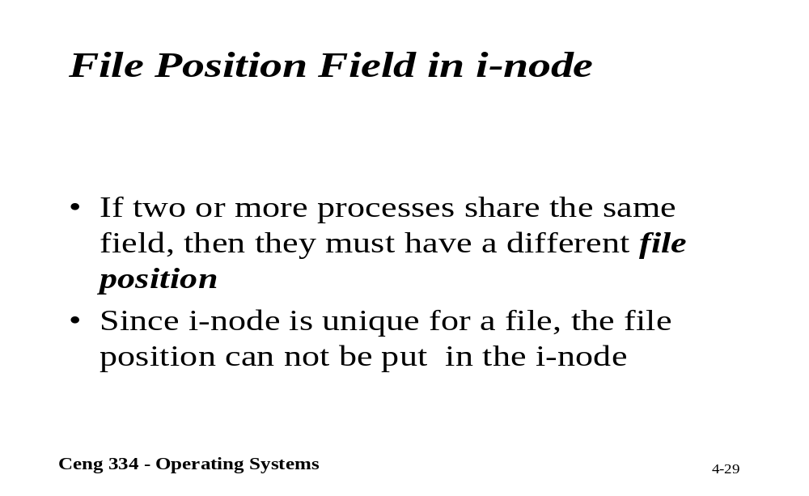
File Position in i-node

Slide 36
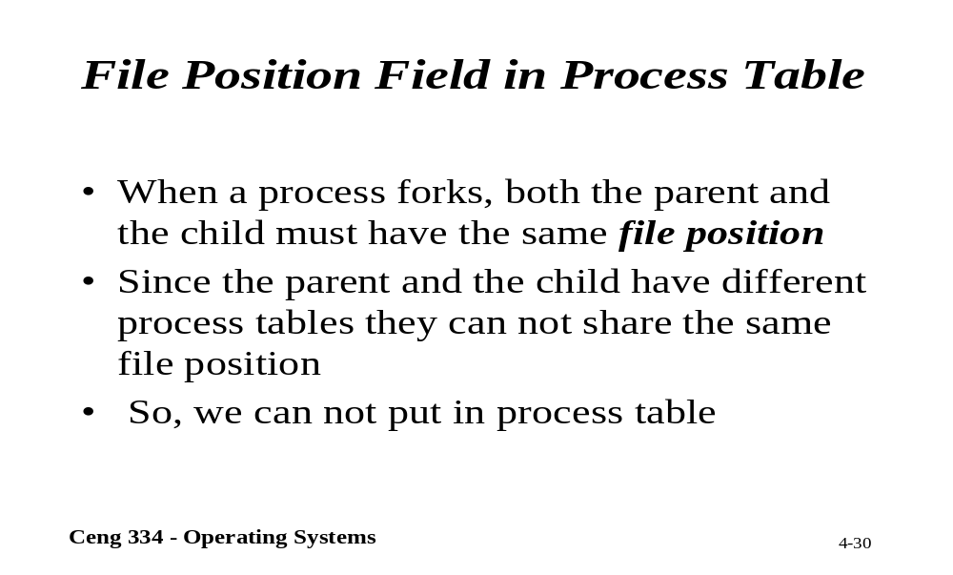
File Position in Process Table

Slide 37
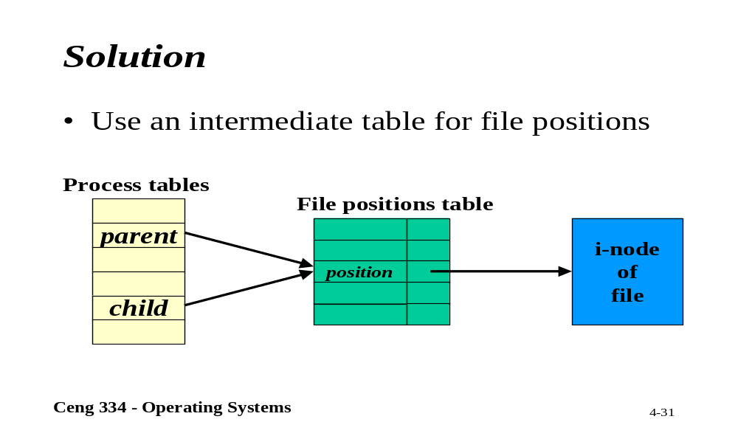
Solution

